Slide 1
Raytracing
Walter Svenddal and Ricky Faure

Slide 2
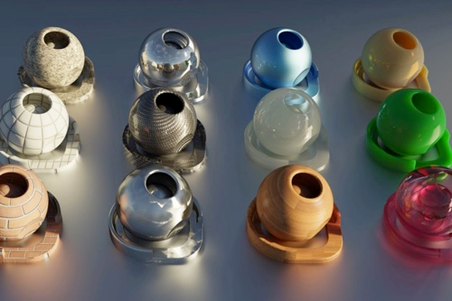
What is raytracing?
Imitating the path of actual light
Creates hyper-realistic images
Very computationally heavy
Notes:
OpenGL is a “hacky” way of rendering images
If we actually imitate the way light bounces and reflects to your eye, we get much higher realism
However, bouncing light takes much more time

Slide 3
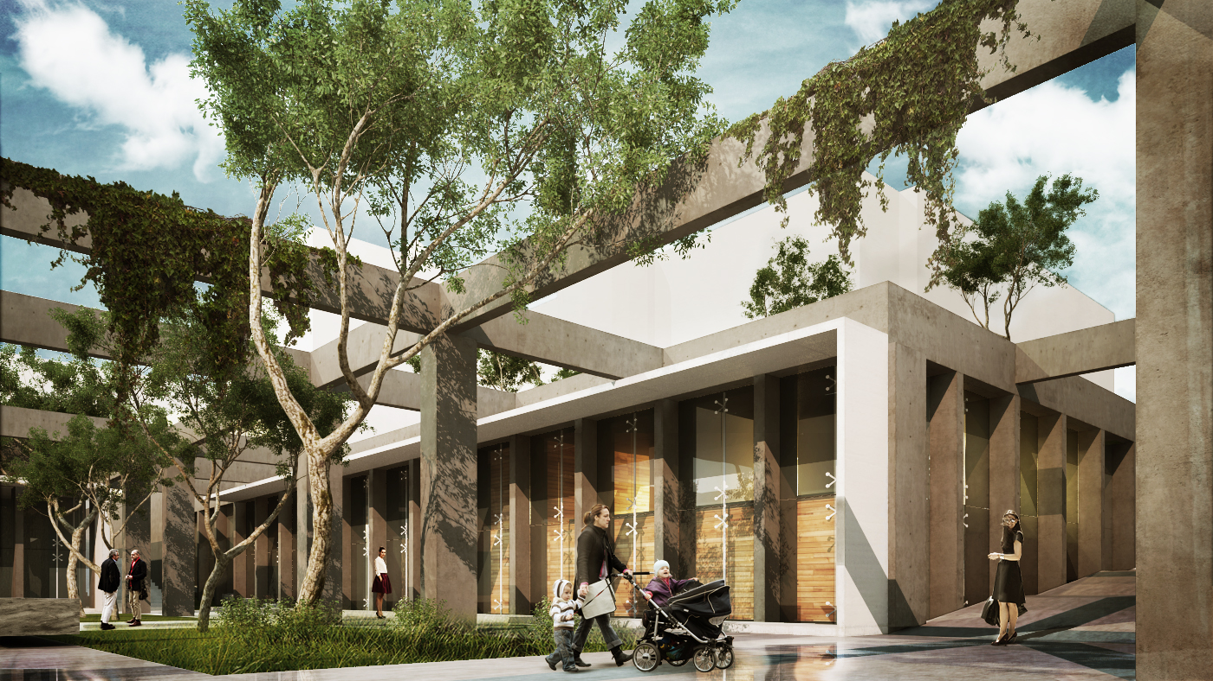
Where is Raytracing used?
Rendering software
Notes:
Rendering software can afford to take more time to make nice pictures

Slide 4
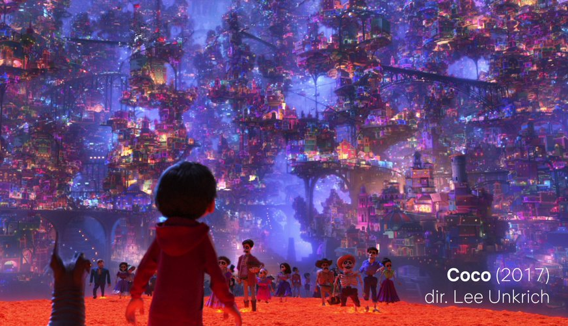
Where is Raytracing used?
Rendering software
Animated movies
Notes:
Pixar uses raytracing to render super realistic images, a single frame takes 29 hours

Slide 5
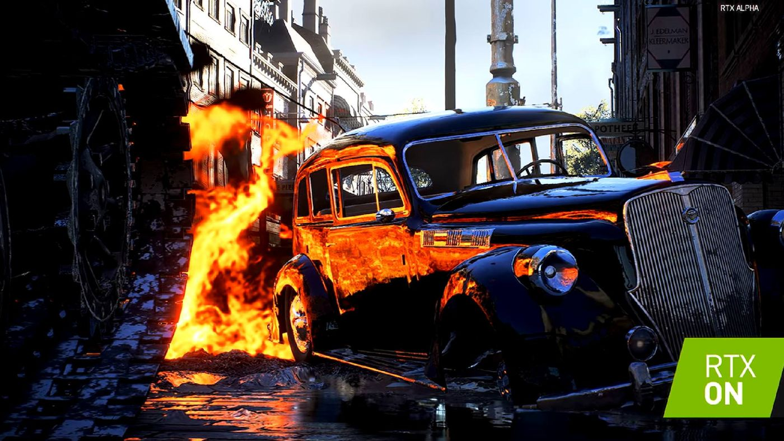
Where is Raytracing used?
Rendering software
Animated movies
Just recently added to video games, such as Battlefield 5
Notes:
Advances in GPU tech have allowed real time (60fps) scenes to be rendered

Slide 6
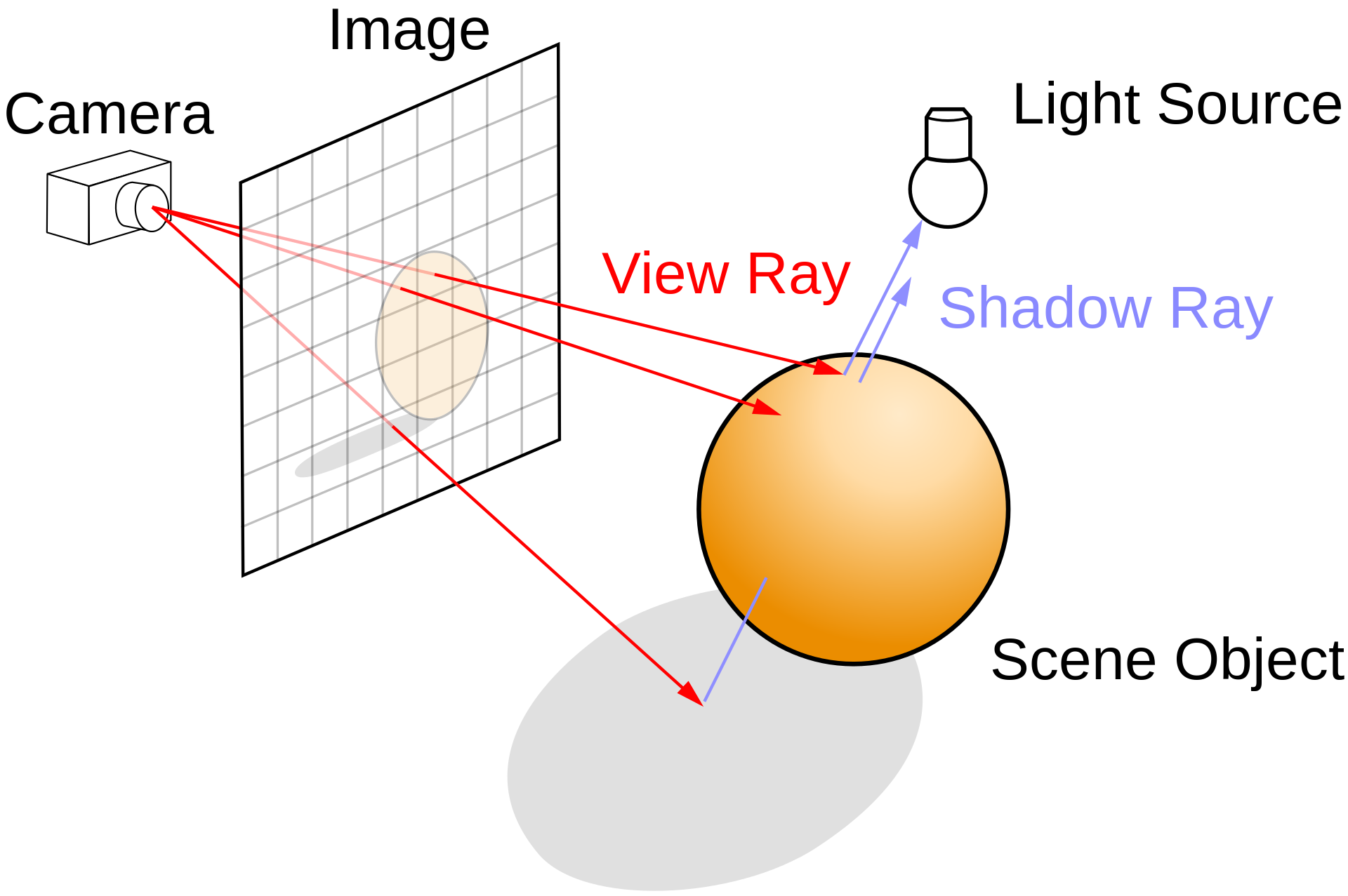
How does Raytracing work?

Slide 7
How did we implement Raytracing
Three.js?
Notes:
Three.js already has a simple raytracing renderer for objects

Slide 8
How did we implement Raytracing
Three.js? Nothing to learn
WebGL?
Notes:
We wouldn’t learn much from using a pre-built renderer.

Slide 9
How did we implement Raytracing
Three.js? Nothing to learn
WebGL? Vertex Shader -> Fragment Shader pipeline doesn’t apply No “compute shaders”
C++ OpenGL?
Notes:
WebGL didn’t support compute shaders, which would allow us to parallelize the raytracing

Slide 10
How did we implement Raytracing
Three.js? Nothing to learn
WebGL? Vertex Shader -> Fragment Shader pipeline doesn’t apply No “compute shaders”
C++ OpenGL? Tons of setup Have to learn new API
???

Slide 11
How did we implement Raytracing
Three.js? Nothing to learn
WebGL? Vertex Shader -> Fragment Shader pipeline doesn’t apply No “compute shaders”
C++ OpenGL? Tons of setup Have to learn new API
We implemented our own Raytracing engine using vanilla Javascript

Slide 12
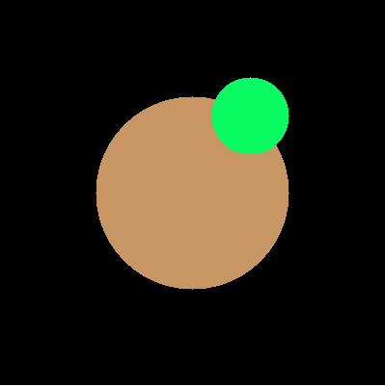
Step 1: Tracing a ray
For each pixel:
Shoot a ray from that pixel
Detect collisions with all objects in the world
Color that pixel the color of the nearest collided object

Slide 13
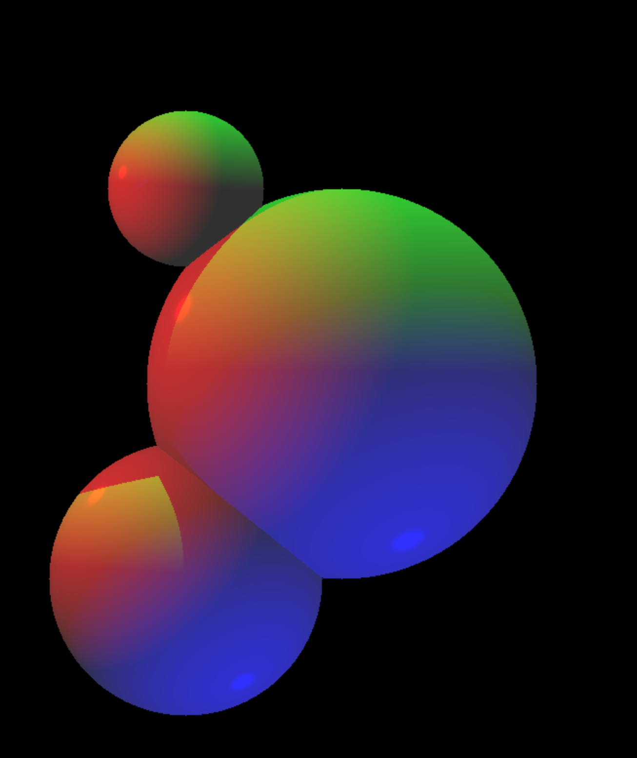
Step 2: Phong lighting
For each collision point:
Trace a “shadow ray” from the collision to each light in world
If that ray collides before reaching the light, add no light
Else, add the light to the color of the intersection ObjectColor * (SpecularColor + AmbientColor + DiffuseColor)

Slide 14
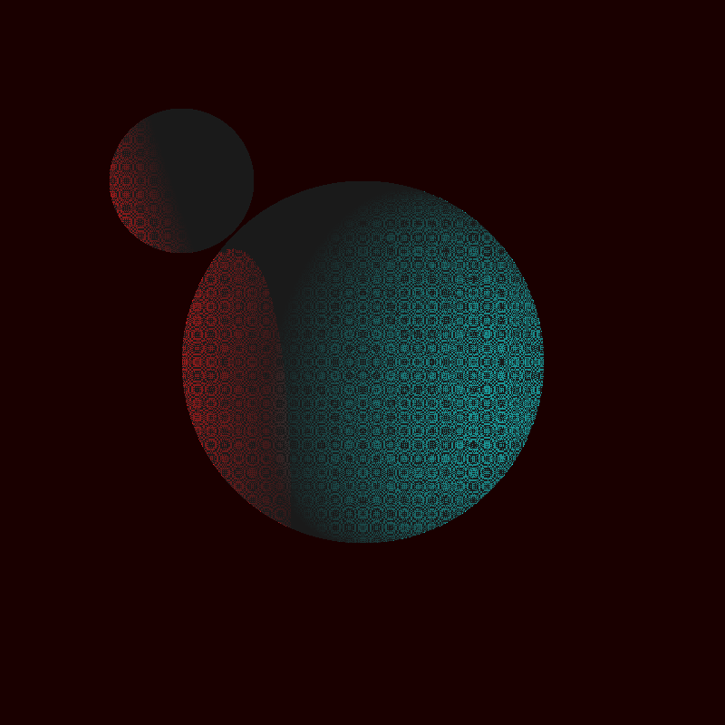
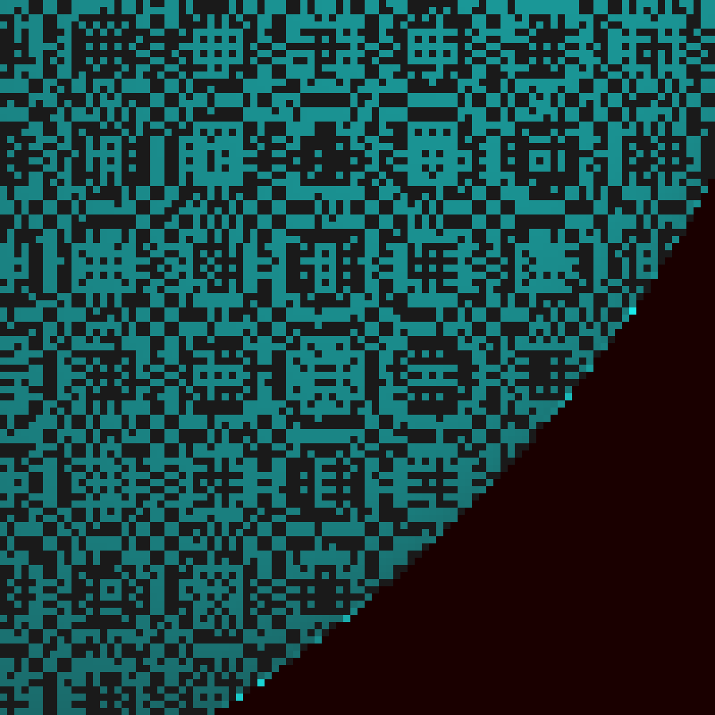
Step 2: Phong lighting
Floating point arithmetic isn’t perfect…
Fix: Rays starting 0.0000001 units inside sphere are considered to be outside

Slide 15
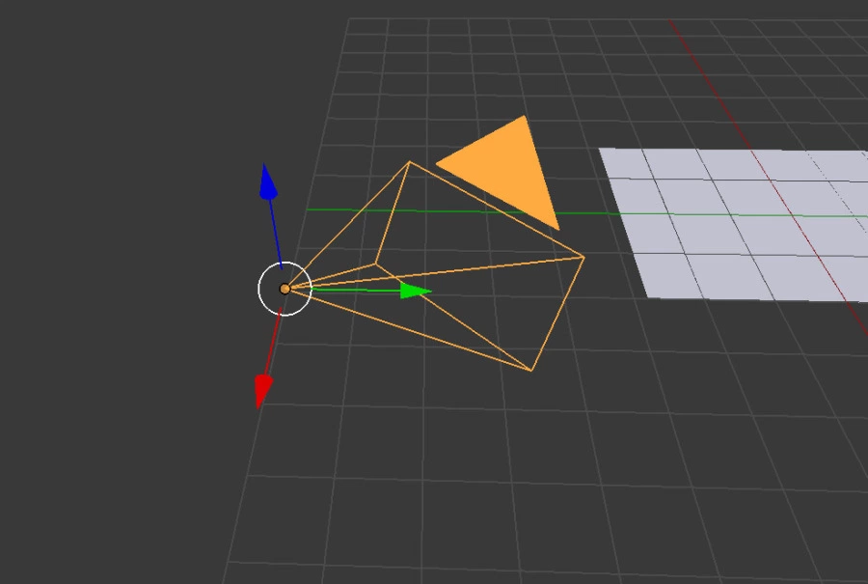
Step 3: Creating a Camera
Surprisingly easy!
No need to reposition world elements according to

Slide 16

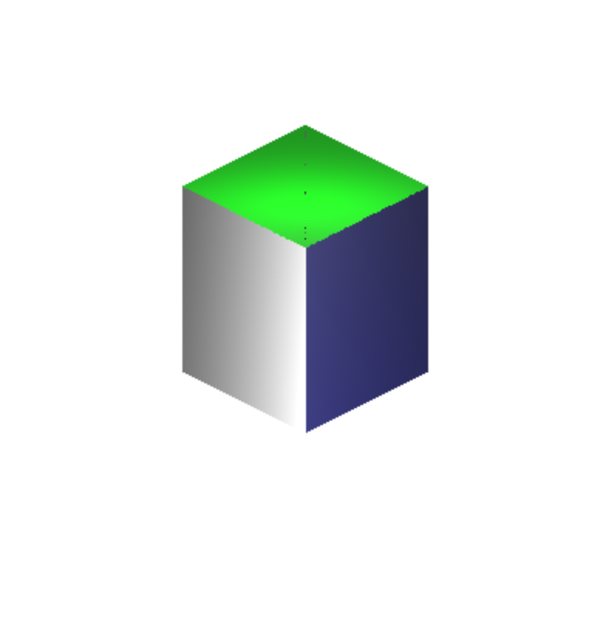
Step 4: Creating new geometry
Triangles
Squares
Cuboids
Oh my!
Anything is possible now!
Moller Trumbore!
Notes:
Moller Trumbore is a fast algorithm used to calculate collisions between rays and triangles.

Slide 17
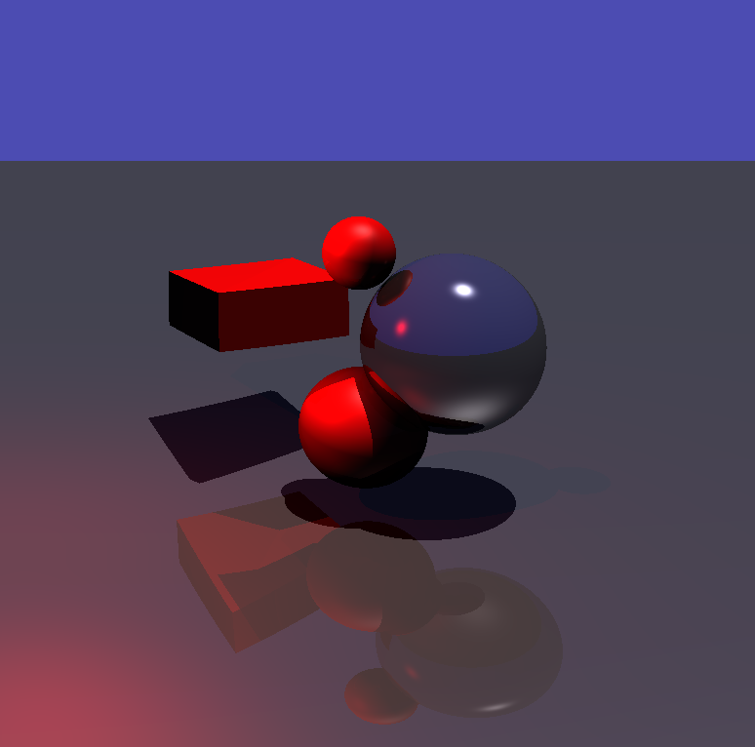
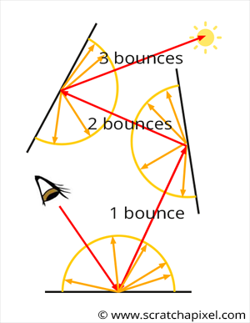
Step 5: Ray bouncing
Recursive ray bouncing
New light system
Reflectivity
Smoothness
Absorption
Color

Slide 18
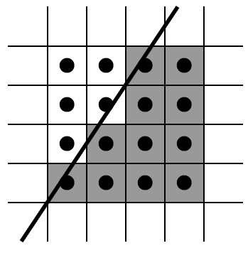
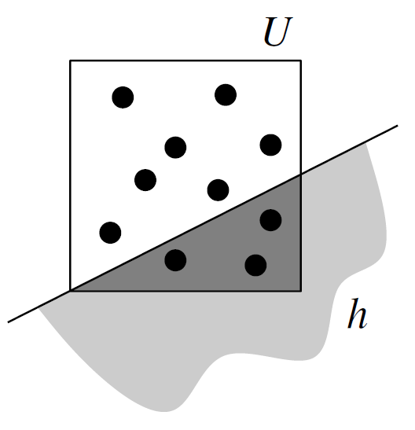
Future features
Random Sampling
Random Diffusion/Reflection
Transparency
Bounding volume box
Textures
Single ray per pixel
Multiple rays per pixel

Slide 19
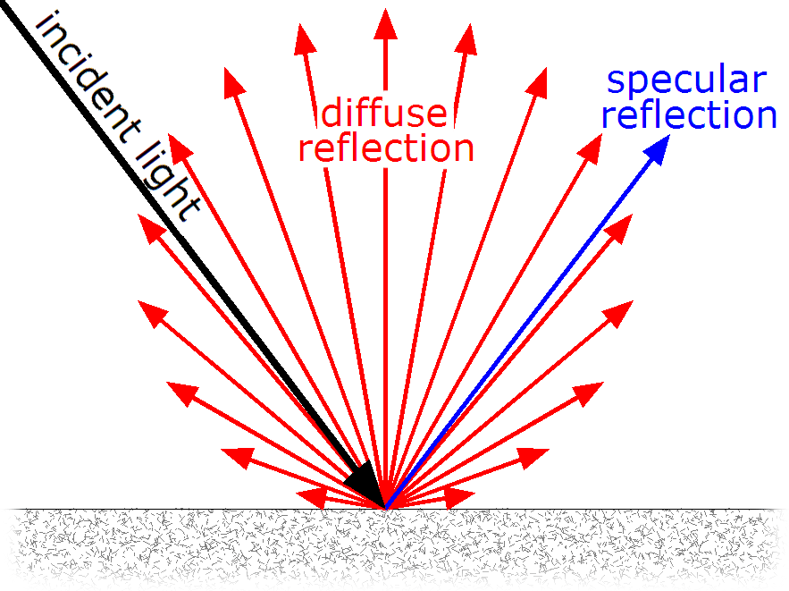
Future features
Random Sampling
Random Diffusion/Reflection
Transparency
Bounding volume box
Textures

Slide 20
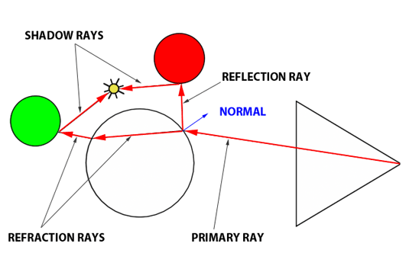
Future features
Random Sampling
Random Diffusion/Reflection
Transparency
Bounding volume box
Textures

Slide 21
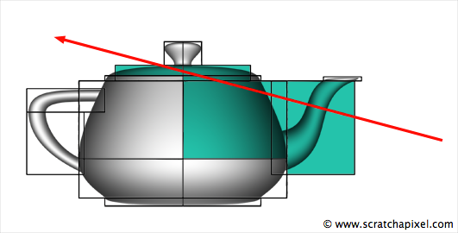
Future features
Random Sampling
Random Diffusion/Reflection
Transparency
Bounding volume box
Textures

Slide 22
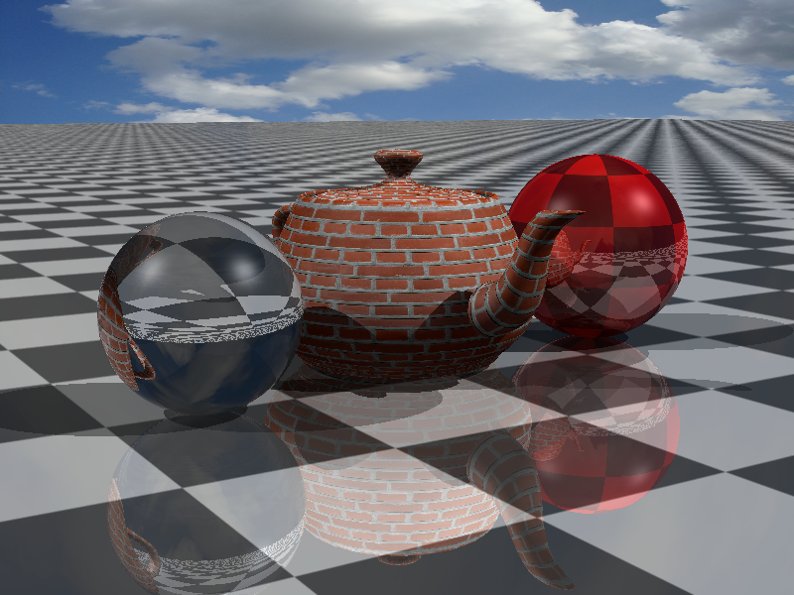
Future features
Random Sampling
Random Diffusion/Reflection
Transparency
Bounding volume box
Textures

Slide 23
References
https://developer.nvidia.com/discover/ray-tracing
https://www.scratchapixel.com/lessons/3d-basic-rendering/introduction-to-ray-tracing
Berg. Computational geometry : algorithms and applications. Berlin: Springer, 2008. Print.

